Slide 1



The local food environment and its association with the dietary quality of mothers
Christina Black
NIHR Doctoral Research Fellow
MRC Lifecourse Epidemiology Unit
12th June 2014
Notes:
Good afternoon. My research spans two disciplines, nutrition and geography. Today I’ll be presenting findings from my PhD, which explored whether the local food environment was associated with dietary quality of mothers with young children and whether this association varied by mothers’ educational attainment.

Slide 2
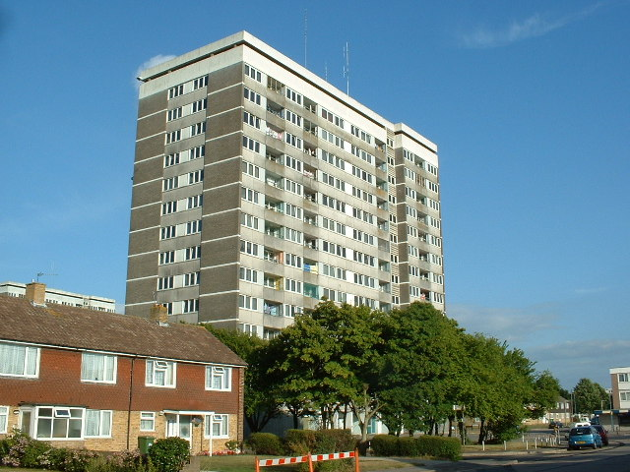

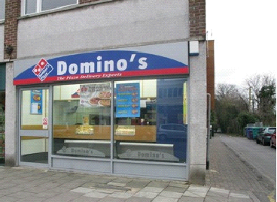
Black et al, Health & Place 2014
Caspi et al, Health & Place 2012
Notes:
There is evidence across high-income countries that fast food outlets are more prevalent in disadvantaged neighbourhoods than more affluent neighbourhoods and speculation that these differences in food outlet access may be contributing to dietary inequalities. The evidence for an association between food outlet access and dietary behaviours however is unclear but may be due to limitations with the methodology of the current literature.

Slide 3
Methodological limitations
Food outlets
Home/ frequently visited locations
Few studies have:
Linked activity space exposures to dietary outcomes
Measured the full range of food outlets
Assessed the moderating role of level of education
Perchoux et al, Health & Place 2013
Zenk et al, Health & Place 2011
Notes:
A key methodological limitation is the assumption that people shop and their food choices are largely influenced by food outlets close to their homes. Residential administrative units such as electoral ward or buffer zones around home have been commonly used but these measures may be missing important exposures (shown here). There has been a move to use activity spaces which include the area around other locations such as workplace in addition to home (shown here – yellow locations, food outlets dots). Few studies have linked activity space exposures to dietary outcomes.
Two other limitations in the literature. Few studies have measured the full range of food outlets, with most research relying on proxy measures such as fast food outlets for less healthy foods and supermarkets for healthy foods. Also few studies have investigated the moderating effect of level of education, which has been shown to be one of the strongest predictors of dietary quality.
This study addresses these limitations.

Slide 4
Store type | n | %
Premium supermarket Large supermarket Discount supermarket Small supermarket ‘World’ store Greengrocer Farm shop Health food store Butcher Baker Sandwich shop Convenience store Petrol store Newsagent Confectioner Fast food outlet Chinese takeaway Indian takeaway Fish & chips Other takeaway | 10 (0.5) 32 (2) 35 (2) 127 (7) 63 (4) 41 (2) 7 (0.5) 19 (1) 56 (3) 68 (4) 66 (4) 272 (15) 68 (4) 65 (4) 76 (4) 92 (5) 223 (12) 151 (8) 143 (8) 173 (10)
Total | 1787 (100)
Notes:
These six council areas covered the study area. Mothers who live and shop in these areas were recruited and asked questions about their highest educational qualification, dietary intake and locations frequently visited such as home, main food store, workplace and general practitioner to create an individual activity space. All retail food outlets and takeaways in the study area were identified through observation so food environment score for each mothers’ activity space could be calculated.

Slide 5
Food environment score creation
Mean rating | Delphi study outlet type | Current study outlet category
Healthier food outlets
8.8 (2.1) 8.8 (2.1) 6.3 (2.9) 5.4 (3.2) 5.3 (2.5) 5.0 (2.5) 4.9 (2.7) 4.4 (2.4) 4.3 (3.3) 4.3 (2.9) 3.3 (3.5) 0.8 (1.9) | Fruit and vegetable market Fruit and vegetable store Supermarket – large chain Butcher Ethnic Bakery – bread only Supermarket – mid Deli Health Convenience - fresh Supermarket - discount Bakery – mixed | Farm shop Greengrocer Premium/ large supermarkets Butcher ‘World’ stores N/A Small supermarkets Sandwich shops Health food stores N/A Discount supermarkets Bakery
Less healthy food outlets
-1.1 (4.1) -1.1 (2.3) -1.6 (2.4) -5.0 (0.9) -5.0 (3.6) -8.3 (1.6) | Convenience – non fresh Takeaway – food court Takeaway – (Asian/Indian) Takeaway – independent Other – miscellaneous Takeaway – major chain | Convenience/ petrol stores N/A Chinese/ Indian takeaways Fish & chips/ Other takeaways Newsagents/ confectioners Fast food outlets
Thornton and Kavanagh, Nutrition & Diabetes 2012
Notes:
Food environment scores represent a novel exposure measure that used the weightings shown in the first column here to create healthy and less healthy environment scores. The weightings were derived researchers in the food environment field who weighted food outlets according to the level to which they encourage healthy and less healthy food choices.

Slide 6



Example:
(8.8 x n
)+(6.3 x n
) =
Healthy
FES
(1.1 x n
)+(8.3 x n
) =
Less healthy
FES
Healthy
FES
Less healthy
FES
Overall
FES
-
=
Notes:
Scores were created, by multiplying the weighting for each food outlet types by the number of outlet in each mothers activity space. The weighted scores were added to create a healthy and a less healthy food environment score for each mother. An overall score was calculated by taking the difference of the two scores.

Slide 7
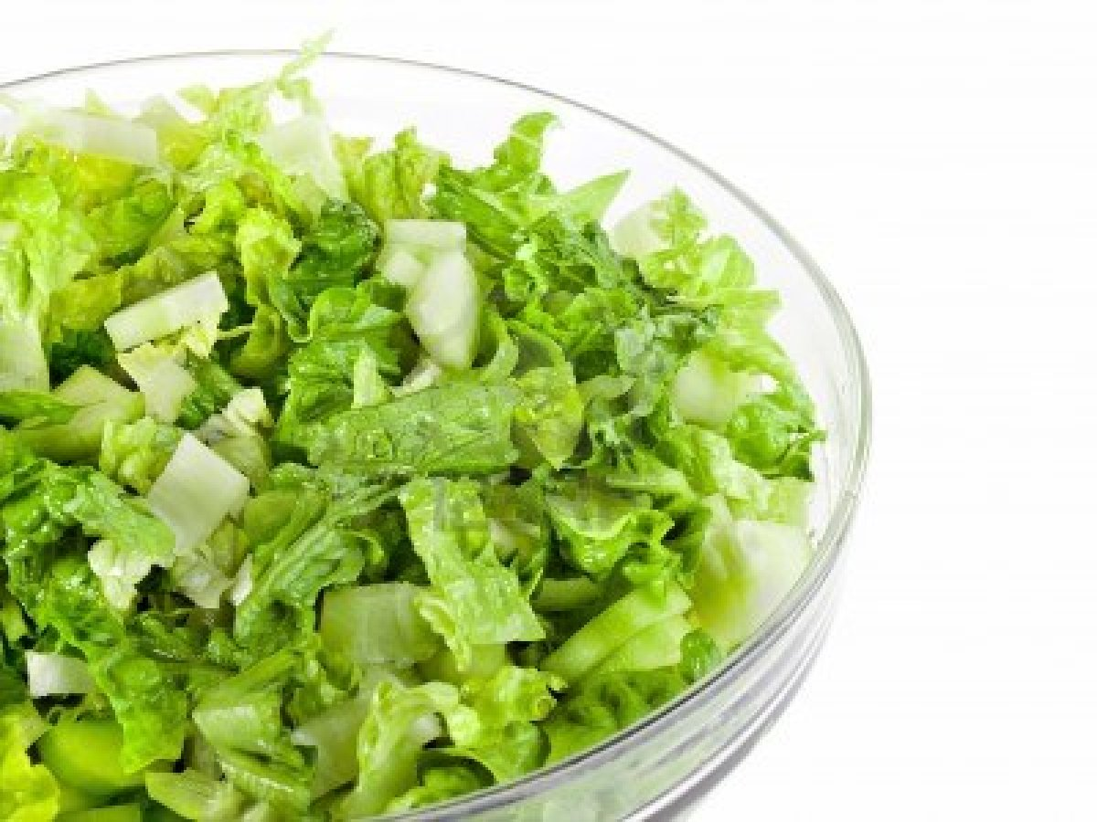




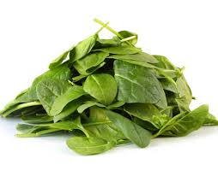






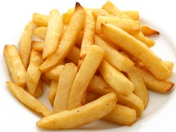







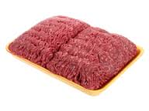



Crozier et al, European Journal of Clinical Nutrition 2010
Notes:
Mothers were asked how often they consumed these foods over the past month. Using a published method standardised quality of diet scores were created for each mother. The sample had a mean of zero and SD of 1. Mothers with positive scores consumed more of the foods above the line and mothers with negative diet score consumed more of the foods below the line.

Slide 8
Mothers’ characteristics by education
 | Low education (≤GCSE) n=307 | Mid education (A-level/HND) n=298 | High education (Degree) n=234
Mothers’ characteristics | Mean (SD) |  |  | p-valueª
Age | 31 (6) | 32 (6) | 34 (5) | <0.001
Number of children | 2 (1) | 1.8 (0.8) | 1.6 (0.7) | <0.001
Diet quality score | -0.44 (0.97) | -0.03 (0.89) | 0.57 (0.88) | <0.001
ª Pearson correlation
Notes:
This slide shows mothers’ characteristics by their level of education. Mothers with low educational attainment were younger, had more children and poorer quality diets than mothers with higher educational attainment.

Slide 9
Environmental factors by education
 | Low education (≤GCSE) n=307 | Mid education (A-level/HND) n=298 | High education (Degree) n=234
Environmental factors | Median (IQR) |  |  | p-valueª
Number of locations | 4 (4,5) | 4 (4,5) | 4 (4,5) | 0.9
Activity space area (km²) | 9.4 (8, 11) | 10 (8, 12) | 9.9 (8, 12) | 0.048
Healthy FES | 94 (65, 127) | 92 (66, 129) | 115 (72, 166) | <0.001
Less healthy FES | 165 (119, 229) | 166 (117, 236) | 199 (134, 302) | 0.003
Overall FES | -74 (-107, -45) | -77 (-111, -42) | -85 (-134, -49) | 0.08
ª Spearman correlation
Notes:
This slide shows mothers’ environmental exposures according to their level of education. There was no difference in the number of locations reported by mothers to create there activity spaces such as home, workplace and GP, but mother’s with higher educational attainment had larger activity spaces than mothers with lower education level. This findings suggests that there locations are further apart than those with a low education level.
Mothers with degrees had the greatest exposure to healthier food outlets and less healthy food outlets. The overall food environment score was the healthy minus the unhealthy and mothers with the lowest education level had the best overall scores while mothers with degrees had the poorest. 99% of mothers had negative overall scores indicating they were exposed to more less healthy food outlets than healthy food outlets.

Slide 10
Overall FES & diet by education
Interaction
(FES & education):
Low & mid p=0.16
Low & high p=0.04
Notes:
This slide shows differences in the relationship between overall food environment score and mothers’ dietary quality by the three levels of education. Overall food environment score is on the x-axis and quality of diet on the y-axis.
The scatter plot for mother with low education level suggests that dietary quality improved as overall food environment score improved. However among mothers with high and mid education levels dietary quality was poorer as the overall food environment score improved.
There was also a significant interaction between the lowest and highest education groups.

Slide 11
Results:
Regression:
mother’s diet score & food environment scores
 | β (95% CI) | p-value
Low education (≤GSCE) Overall food environment score | 0.004 (-0.01, 0.02) | 0.6
Low education (A-levels/HND) Overall food environment score | -0.01 (-0.02, 0.004) | 0.1
High education (Degree) Overall food environment score | -0.02 (-0.04, -0.004) | 0.02
Notes:
Stratified regression analyses confirmed the directional differences between overall food environment and dietary quality across the different levels of education. Mothers with low educational attainment had better quality diets as their food environment score improved, however the relationship was not significant and the effect size was small. Among mothers with higher educational attainment, dietary quality was better for those exposed to poorer food environments and this relationship was strong among mothers with degrees.
The negative relationship observed among mothers with degrees may suggest they have other psychological and financial resources that protect them from poorer environmental exposures. They also have the biggest activity spaces and are able to pick and choose where to food shop.

Slide 12
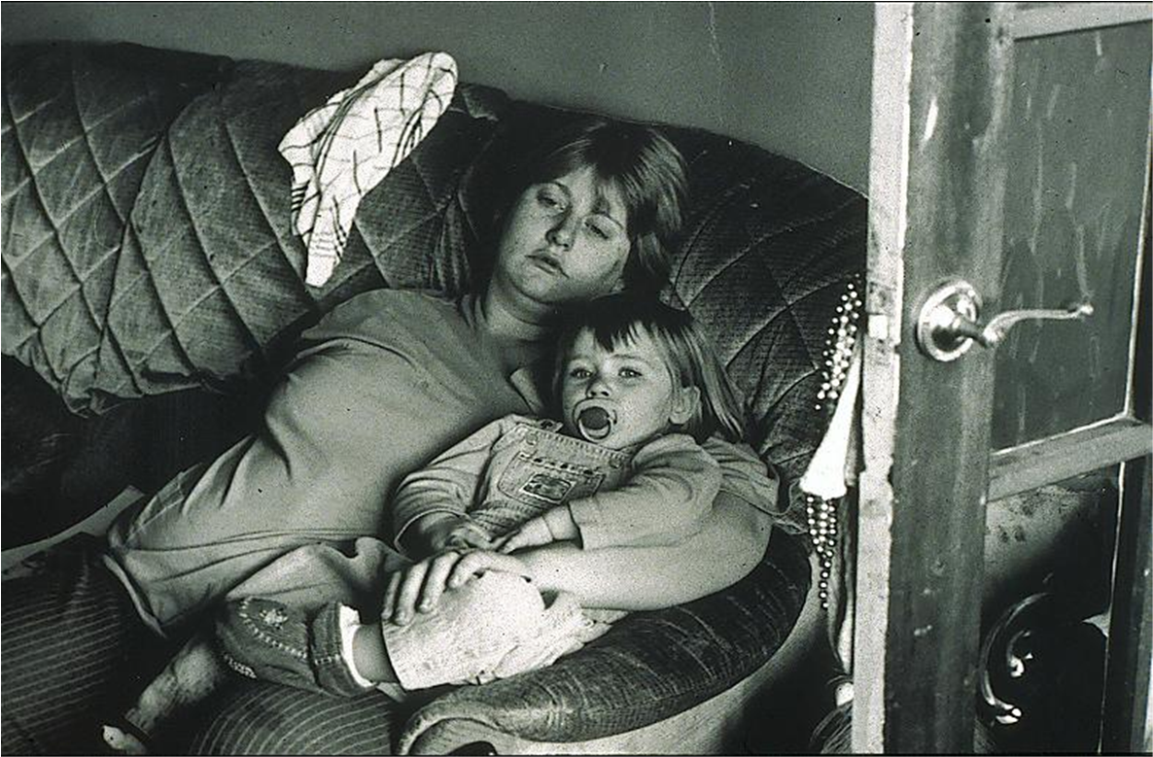
Summary and implications
The direction of relationships between food outlet accessibility and dietary quality differ by education level
Less healthy food outlets are more prevalent than healthier food outlets
Mothers’ with higher education levels may be less susceptible to poorer food outlet exposures than mothers with low education.
Further research testing educational moderation effects is needed
Local authorities could improve the imbalance through planning restrictions, particularly in more deprived areas

Slide 13

Acknowledgements
Thank you to the mothers who took part in our surveys
My supervisors and collaborators:
Dr Janis Baird Prof Steve Cummins
Prof Graham Moon Dr Daniel Lewis
Prof Cyrus Cooper
The Southampton Initiative for Health team
Students and field workers for assistance with data collection
Notes:
Many thanks to…

